Slide 1


CSCE 5640 Operating System Design I/O and File System
Dr. Amar Maharjan
Computer Science and Engineering
University of North Texas
Slides (with some modifications) from:
Operating System Concepts 10 edition – Silberschatz, Galvin and Gagne © 2018

Slide 2

Background
Computer systems must provide mass storage for permanently storing files and data.
Hard disks and nonvolatile memory devices.
Secondary storage devices vary in many aspects.
Sequential vs random access.
Data transfer: synchronous vs asynchronous.
Slowest major component of the computer.
OS needs to provide a wide range of functionality so that applications can control all aspects of the devices.
Key goal: provide simplest interface possible to the rest of the system.
Notes:
Most modern laptops use SSD instead of Hard disks because they are fast, lightweight, and not bulky.

Slide 3
Overview of Mass Storage Structure
Bulk of secondary storage for modern computers is hard disk drives (HDDs) and nonvolatile memory (NVM) devices
HDDs spin platters of magnetically-coated material under moving read-write heads
Drives rotate at 60 to 250 times per second
Transfer rate is rate at which data flow between drive and computer
Positioning time (random-access time) consists of two parts: time to move disk arm to desired cylinder (seek time) and time for desired sector to rotate under the disk head (rotational latency)
Head crash results from disk head making contact with the disk surface -- That’s bad
Disks can be removable
Notes:
Seek time: Move head to the correct track
Reduce seek time and rotational time as much as possible.

Slide 4
Moving-head Disk Mechanism

Slide 5
Other Secondary Storage Devices
Nonvolatile Memory Devices
Magnetic Tape
Optical Disks

Slide 6
Disk Structure
Disk drives are addressed as large 1-dimensional arrays of logical blocks, where the logical block is the smallest unit of transfer
Low-level formatting creates logical blocks on physical media
The 1-dimensional array of logical blocks is mapped into the sectors of the disk sequentially
Sector 0 is the first sector of the first track on the outermost cylinder
Mapping proceeds in order through that track, then the rest of the tracks in that cylinder, and then through the rest of the cylinders from outermost to innermost
Notes:
Hard disk: Array of logical block
Low-level formatting fills the device with a special data structure for each storage location. The data structure for a sector or page typically consists of a header, a data area, and a trailer. The header and trailer contain information used by the controller, such as a sector/page number and an error detection or correction code.
Logical to physical address should be easy
Except for bad sectors
Non-constant # of sectors per track via constant angular velocity

Slide 7
HDD Scheduling
The operating system is responsible for using hardware efficiently — for the disk drives, this means having a fast access time and disk bandwidth.
Access time has two major components
Seek time is the time for the disk to move the heads to the cylinder containing the desired sector.
Rotational latency is the additional time waiting for the disk to rotate the desired sector to the disk head.
Minimize seek time
Seek time ≈ seek distance
Disk bandwidth is the total number of bytes transferred, divided by the total time between the first request for service and the completion of the last transfer.
We can improve both the access time and the bandwidth by managing the order in which storage I/O requests are serviced.

Slide 8
Disk Scheduling (Cont.)
Several algorithms exist to schedule the servicing of disk I/O requests.
We illustrate them with a request queue (0-199).
For example: 98, 183, 37, 122, 14, 124, 65, 67
Current head pointer 53

Slide 9
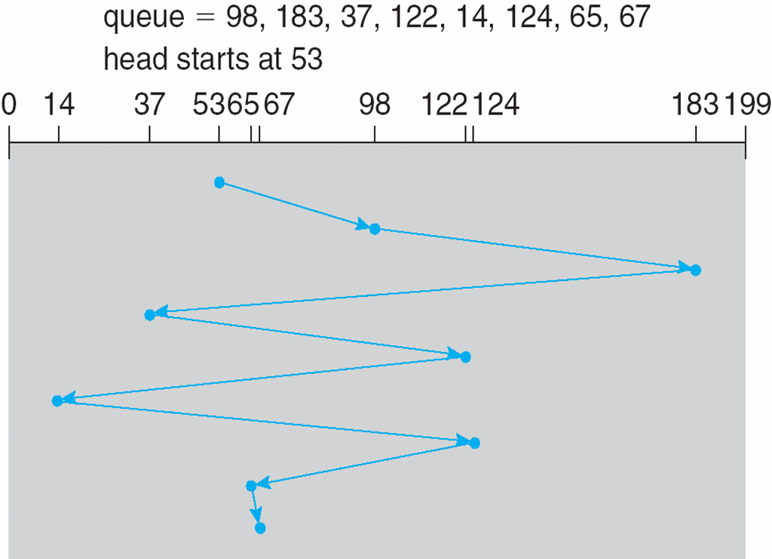
FCFS
Illustration shows total head movement of 640 cylinders
Notes:
Seek time = 130+146+122+85+108+110+59+2 = 640

Slide 10
SCAN Scheduling
The disk arm starts at one end of the disk, and moves toward the other end, servicing requests until it gets to the other end of the disk, where the head movement is reversed, and servicing continues.
SCAN algorithm sometimes called the elevator algorithm
Illustration shows total head movement of 208 cylinders
Notes:
But note that if requests are uniformly dense, largest density at other end of disk and those wait the longest

Slide 11
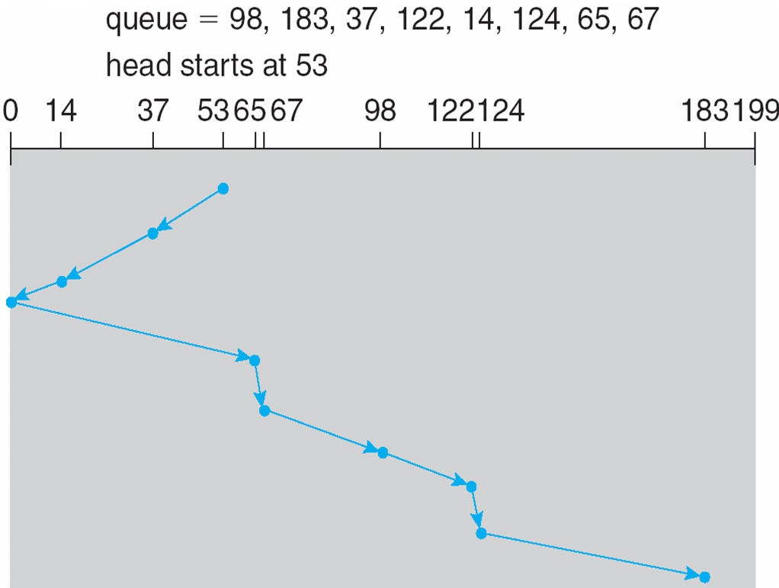
SCAN (contd.)
Notes:
Seek time = 208

Slide 12
C-SCAN Scheduling
Provides a more uniform wait time than SCAN
The head moves from one end of the disk to the other, servicing requests as it goes
When it reaches the other end, however, it immediately returns to the beginning of the disk, without servicing any requests on the return trip
Treats the cylinders as a circular list that wraps around from the last cylinder to the first one
Notes:
Circular SCAN
Total number of cylinders?

Slide 13
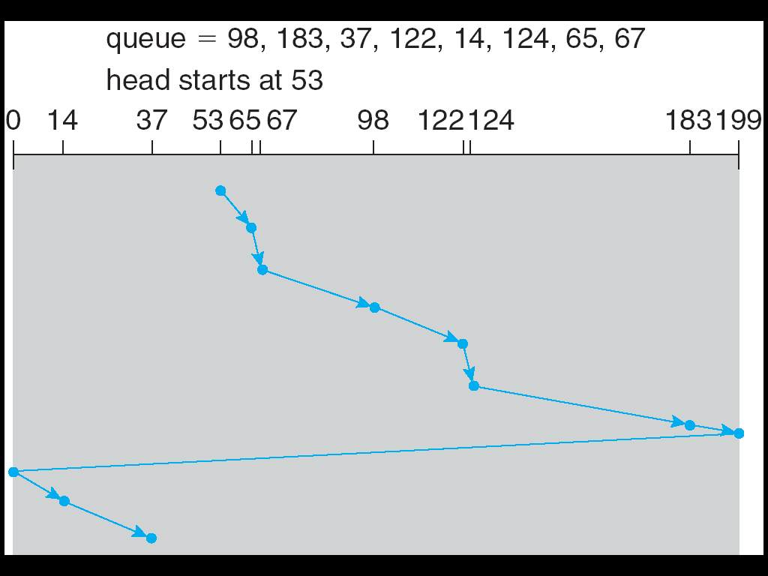
C-SCAN (Cont.)
Notes:
Going from 199 to 0 is not a seek time.

Slide 14
Operating System Issues
Major OS jobs are to manage physical devices and to present a virtual machine abstraction to applications
For hard disks, the OS provides two abstractions:
Raw device – an array of data blocks.
File system – the OS queues and schedules the interleaved requests from several applications.

Slide 15
File Management
File is a named, ordered collection of information
Files are mapped by the operating system onto physical mass-storage devices.
A file system describes how files are mapped onto physical devices, as well as how they are accessed and manipulated by both users and programs.
Accessing physical storage can often be slow, so file systems must be designed for efficient access.
Other requirements may be important as well, including providing support for file sharing and remote access to files.
Notes:
It is a fundamental unit.
Files are mapped into a hard-disk drive.

Slide 16
File Concept
OS provides a uniform logical view of stored information.
A file is a named collection of related information that is recorded on secondary storage.
Types:
Data
Numeric
Character
Binary
Program
Contents defined by file’s creator
Many types
text file,
source file,
executable file
Notes:
Binary: Create a class structure, store data in that and store the structure in binary format.
OS abstracts from the physical properties of its storage devices to define a logical storage unit: file
UNIX, Linux, and some other operating systems provide a proc file system that uses file-system interfaces to provide access to system information (such as process details).

Slide 17
File Attributes
Name – only information kept in human-readable form
Identifier – unique tag (number) identifies file within file system
Type – needed for systems that support different types
Location – pointer to file location on device
Size – current file size
Protection – controls who can do reading, writing, executing
Time, date, and user identification – data for protection, security, and usage monitoring
Information about files are kept in the directory structure, which is maintained on the disk
Many variations, including extended file attributes such as file checksum
Information kept in the directory structure

Slide 18
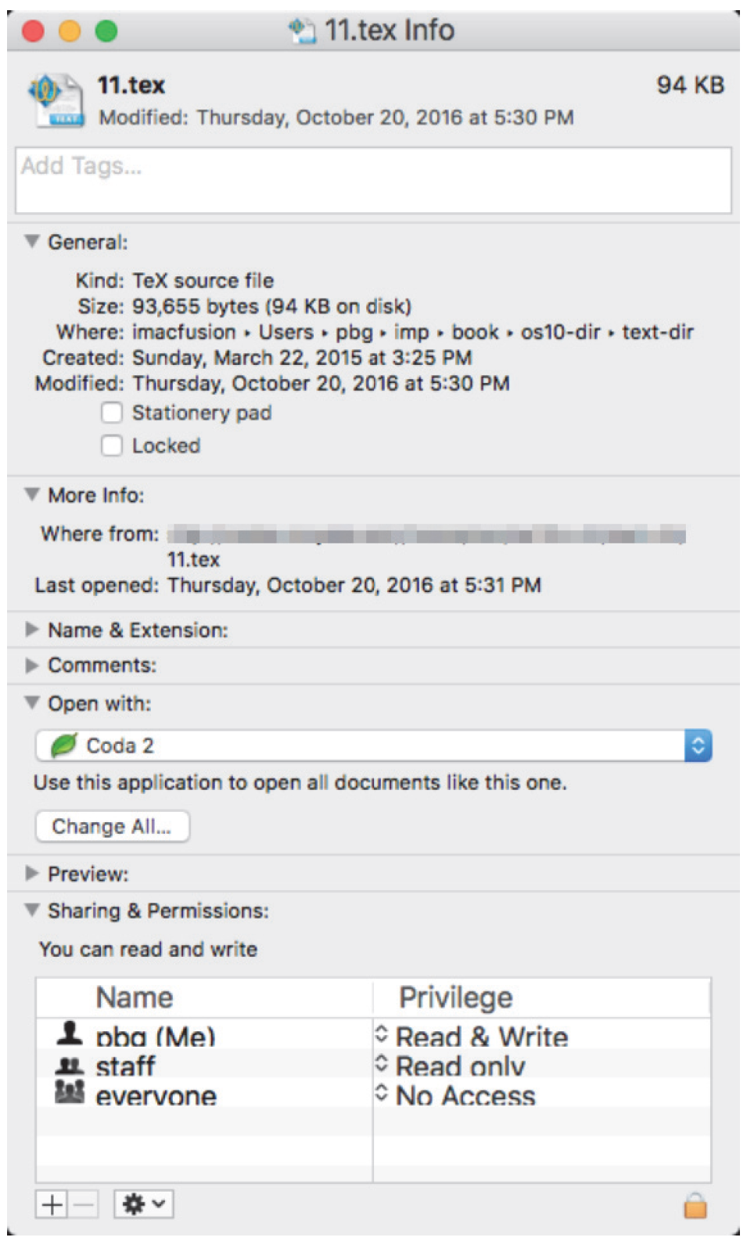
File info Window on Mac OS X
Notes:
tex, latex: Used to write research papers

Slide 19
Directory Structure
A collection of nodes containing information about all files
Both the directory structure and the files reside on disk
Operations
Search for a file
Create a file
Delete a file
List a directory
Rename a file
Traverse the file system
Notes:
The directory can be viewed as a symbol table that translates file names into their file control blocks

Slide 20
Directory Organization
Efficiency – locating a file quickly
Naming – convenient to users
Two users can have same name for different files
Grouping – logical grouping of files by properties, (e.g., all Java programs, all games, …)
Notes:
We cannot create two files with the same name at the same location.
The same file can have several different names

Slide 21
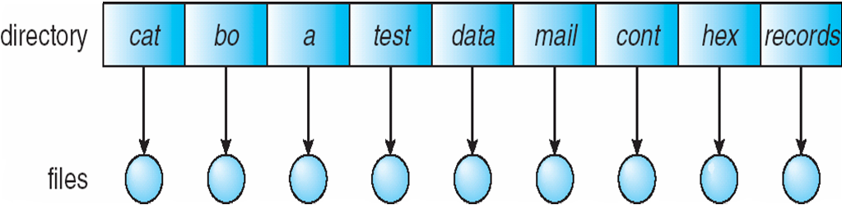
Single-Level Directory
A single directory for all users
Naming problem
Grouping problem

Slide 22
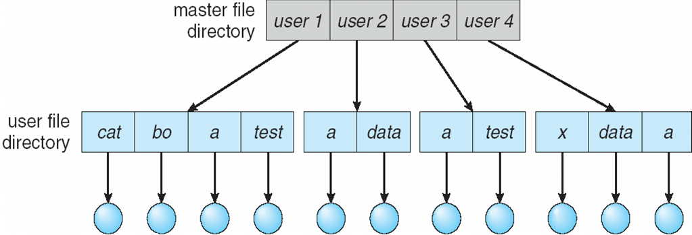
Two-Level Directory
Separate directory for each user
Path name
Can have the same file name for different user
Efficient searching
No grouping capability
Notes:
Every user has its own directories.
Benefit: Multiple users can have the same file name.
Searching is easy: Each has a certain amount of files.

Slide 23
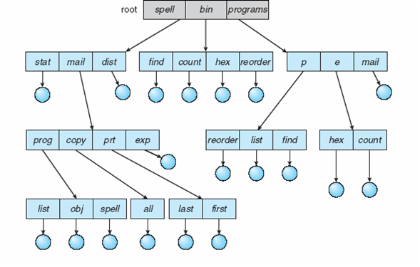
Tree-Structured Directories
Notes:
Bin: binary
Limitation: Multiple users are trying to use a single file.
A directory (or subdirectory) contains a set of files or subdirectories.
In many implementations, a directory is simply another file, but it is treated in a special way.
All directories have the same internal format.
One bit in each directory entry defines the entry as a file (0) or as a subdirectory (1).

Slide 24
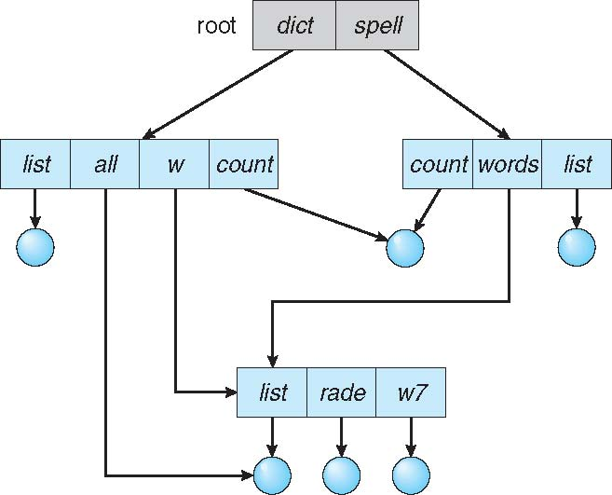
Acyclic-Graph Directories
Have shared subdirectories and files
Notes:
Multiple users can create the same file, which is shared by multiple users.
No-cycle.
The count can be a text file or any file.
Ex: Shortcut on windows.

Slide 25
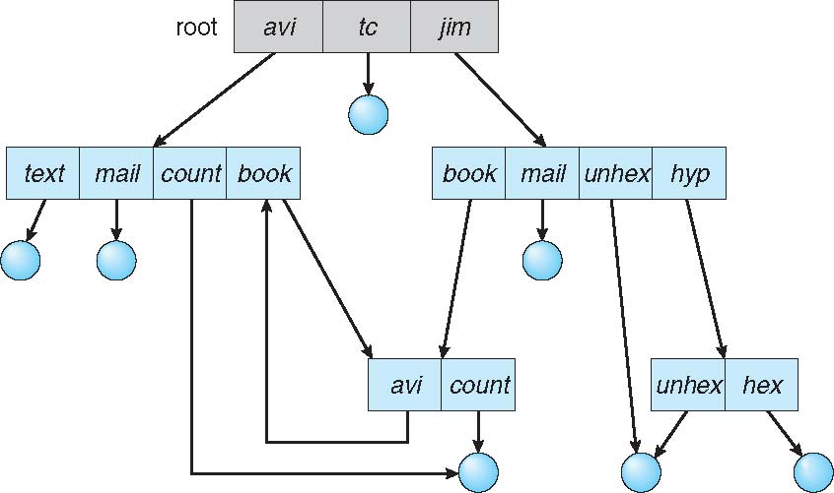
General Graph Directory
Notes:
If there is a cycle, book-av, the problem is during the search operation if we are not careful, we can get stuck in an infinite loop.

Slide 26
General Graph Directory (Cont.)
We want to avoid traversing shared sections of an acyclic graph twice, mainly for performance reasons.
Deleting a file? – Use Garbage collection (GC):
Determine when the last reference has been deleted and the disk space can be reallocated.
Involves traversing the entire file system, marking everything that can be accessed.
Then, a second pass collects everything that is not marked onto a list of free space
GC for a disk-based file system, however, is extremely time consuming and is thus seldom attempted.
How do we know when a new link will complete a cycle?
Use algorithms to detect cycles in graphs: computationally expensive
Simpler approach: bypass links during directory traversal.
Cycles are avoided, and no extra overhead is incurred.
Notes:
If no one is referencing the file, we can delete it, but in cyclic we it is possible that same file can be reffered from multiple files.
If we have cycle then we need to use garbage collection.
Garbage collection is expensive and not used frequently.
A similar problem exists when we are trying to determine when a file can be deleted.
With acyclic-graph directory structures, a value of 0 in the reference count means that there are no more references to the file or directory, and the file can be deleted.
However, when cycles exist, the reference count may not be 0 even when it is no longer possible to refer to a directory or file.
This anomaly results from the possibility of self-referencing (or a cycle) in the directory structure

Slide 27
Protection
File owner/creator should be able to control:
What can be done
By whom
Types of access
Read
Write
Execute
Append
Delete
List
Notes:
We can control who can read, write, etc.

Slide 28
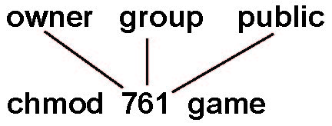
Access Lists and Groups in Unix
Mode of access: read, write, execute
Three classes of users on Unix / Linux
RWX
a) owner access 7 ⇒ 1 1 1 RWX
b) group access 6 ⇒ 1 1 0
RWX
c) public access 1 ⇒ 0 0 1
Ask manager to create a group (unique name), say G, and add some users to the group.
For a file (say game) or subdirectory, define an appropriate access.
Attach a group to a file
chgrp G game
Notes:
Public access can also be referred to as other access.
X: Execute file
chgrp: Change group
chmod: Change mode, change access permission.

Slide 29
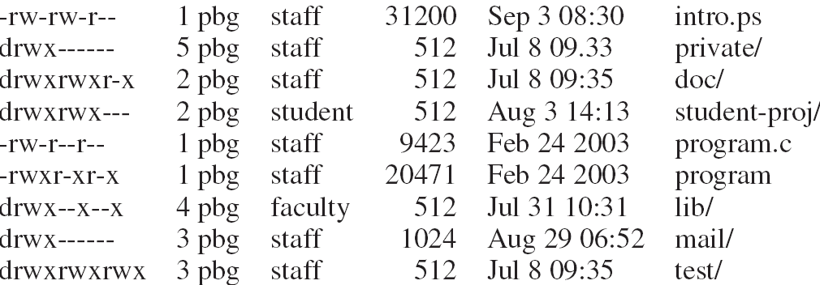
A Sample UNIX Directory Listing
Notes:
1st character:
- : File
d: Directory
Command: ls -l
1 pbg: Owner
Staff: Group the file belongs to.
31200; Size of file
Last modified date and time
rw-rw-r-- : Owner (rw-), Group (rw-), Other/Public (r--)

Slide 30
Windows 7 Access-Control List Management

Slide 31
File-System Structure
File structure
Logical storage unit
Collection of related information
File system resides on secondary storage (disks)
Provided user interface to storage, mapping logical to physical
Provides efficient and convenient access to disk by allowing data to be stored, located retrieved easily
Disk provides in-place rewrite and random access
I/O transfers performed in blocks of sectors (usually 512 bytes)
File control block (FCB) – storage structure consisting of information about a file
Device driver controls the physical device
File system organized into layers

Slide 32
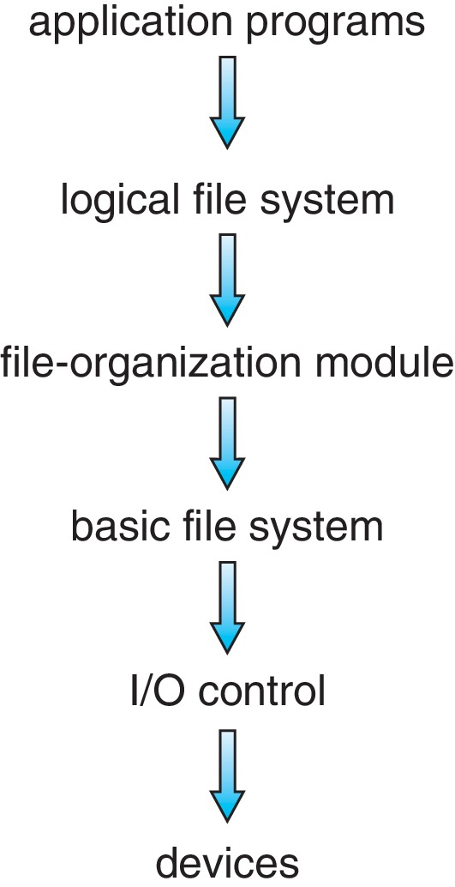
Layered File System
The logical file system manages metadata information. Metadata includes all of the file-system structure except the actual data (or contents of the files).
The file-organization module knows about files and their logical blocks. Each file’s logical blocks are numbered from 0 (or 1) through N.
The basic file system issues generic commands to the appropriate device driver to read and write blocks on the storage device.
The I/O control level consists of device drivers and interrupt handlers to transfer information between the main memory and the disk system.
Notes:
The I/O control level consists of device drivers and interrupt handlers to transfer information between the main memory and the disk system.
A device driver can be thought of as a translator. Its input consists of high-level commands, such as “retrieve block 123.”
The basic file system (called the “block I/O subsystem” in Linux) needs only to issue generic commands to the appropriate device driver to read and write blocks on the storage device. It issues commands to the drive based
on logical block addresses.
The file-organization module knows about files and their logical blocks. Each file’s logical blocks are numbered from 0 (or 1) through N.
The logical file system manages metadata information. Metadata includes all of the file-system structure except the actuafile, including ownership, permissions, and location of the file contentsl data (or contents of the files).
A file control block (FCB) (an inode in UNIX file systems) contains information about the.

Slide 33
Directory Implementation
The selection of directory-allocation and directory-management algorithms significantly affects the efficiency, performance, and reliability of the file system.
Linear list of file names with pointer to the data blocks
Simple to program
Time-consuming to execute
Linear search time
Could keep ordered alphabetically via linked list or use B+ tree
Hash Table – linear list with hash data structure
Decreases directory search time
Collisions – situations where two file names hash to the same location
Only good if entries are fixed size, or use chained-overflow method
Notes:
Linear list: Linked list of files.
Searching is time-consuming.
Hash table: If we use this, we must tell the size upfront. Has a fixed table size.
Searching is faster, and this is better than a linear list.

Slide 34
Allocation Methods
An allocation method refers to how disk blocks are allocated for files:
Contiguous
Linked
File Allocation Table (FAT)
Notes:
The actual content of the file is stored in blocks known as sectors.
The blocks may be stored sequentially or at different locations.
These are the block storage techniques.

Slide 35
Contiguous Allocation
Each file occupies set of contiguous blocks
Best performance in most cases
Simple – only starting location (block #) and length (number of blocks) are required
Problems include:
Finding space on the disk for a file,
Knowing file size,
External fragmentation, need for compaction off-line (downtime) or on-line

Slide 36
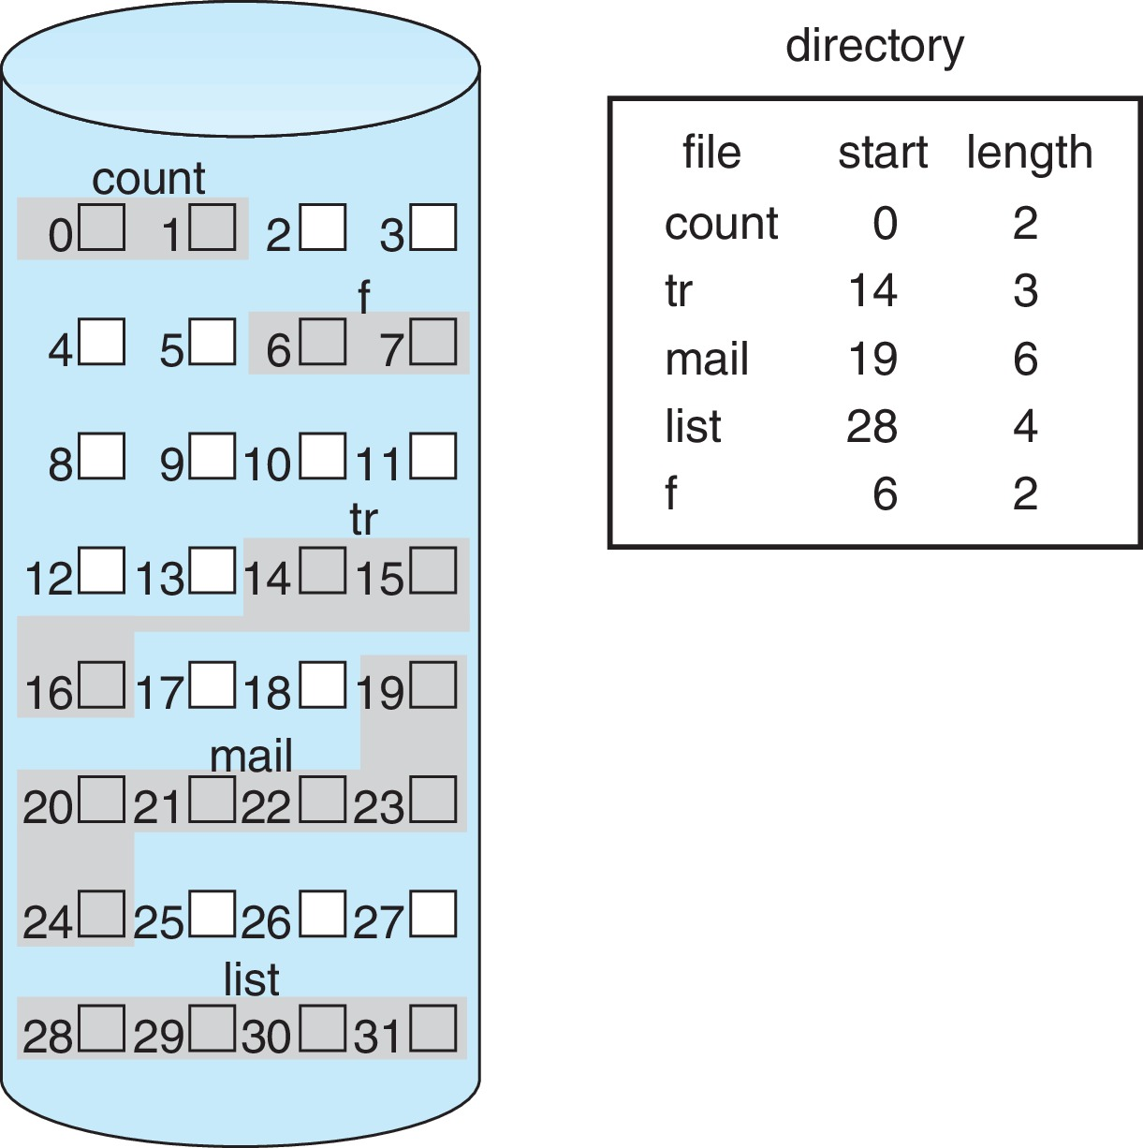
Contiguous Allocation (Cont.)
Notes:
Five files in the directory.
What if we want 3 more blocks for ‘tr’, we can’t, because there is no place.
We can solve this using the method, see next slides…

Slide 37
Extent-Based Systems
Many newer file systems (i.e., Veritas File System) use a modified contiguous allocation scheme
Extent-based file systems allocate disk blocks in extents
An extent is a contiguous block of disks
Extents are allocated for file allocation
A file consists of one or more extents
Notes:
A contiguous chunk of space is allocated initially.
Then, if that amount proves not to be large enough, another chunk of contiguous space, known as an extent, is added.
The location of a file’s blocks is then recorded as a location and a block count, plus a link to the first block of the next extent.

Slide 38
Linked Allocation
Each file is a linked list of blocks
File ends at nil/null pointer
No external fragmentation
Each block contains pointer to next block
No compaction, external fragmentation
Disadvantages:
Locating a block can take many I/Os and disk seeks – how to find i^{th} block of file?
Space required for pointers – pointer may require 4 bytes (out of 512-byte block)
Improve efficiency by clustering blocks into groups but increases internal fragmentation
Reliability can be a problem: what if a pointer was lost or damaged?
Notes:
To solve the external fragmentation we use this.
Reduce number of pointers: We will not use blocks, instead we use collection/cluster of blocks and we link the clusters.
6 blocks: 6 pointers
3 blocks 1 cluster: 2 pointers
But this can cause internal fragmentation. All the blocks in the cluster may not be used.
If the links are not maintained properly, the data may be lost.
Reliability: Recall that the files are linked together by pointers scattered all over the device, and consider what
would happen if a pointer was lost or damaged.

Slide 39
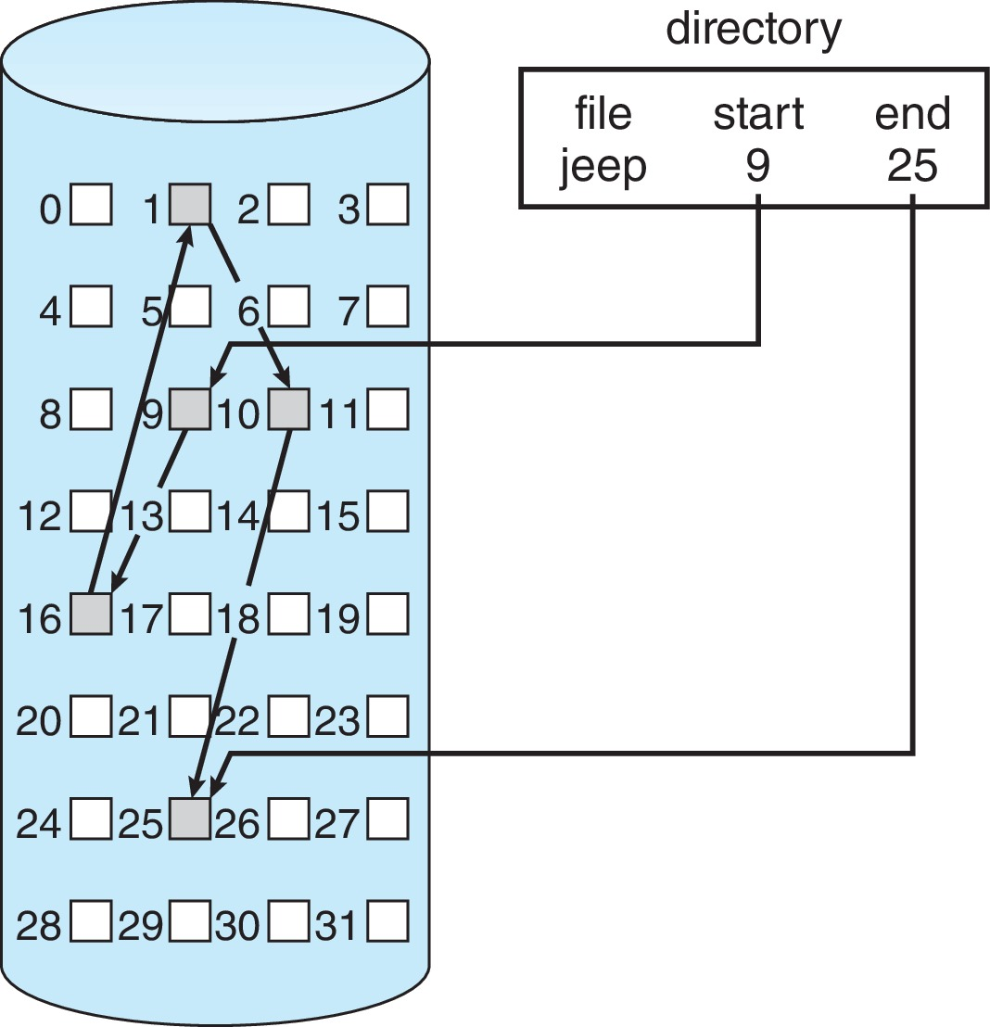
Linked Allocation Example
Each file is a linked list of disk blocks: blocks may be scattered anywhere on the disk
Notes:
Looking at the directory, we can't tell how many blocks are used.

Slide 40
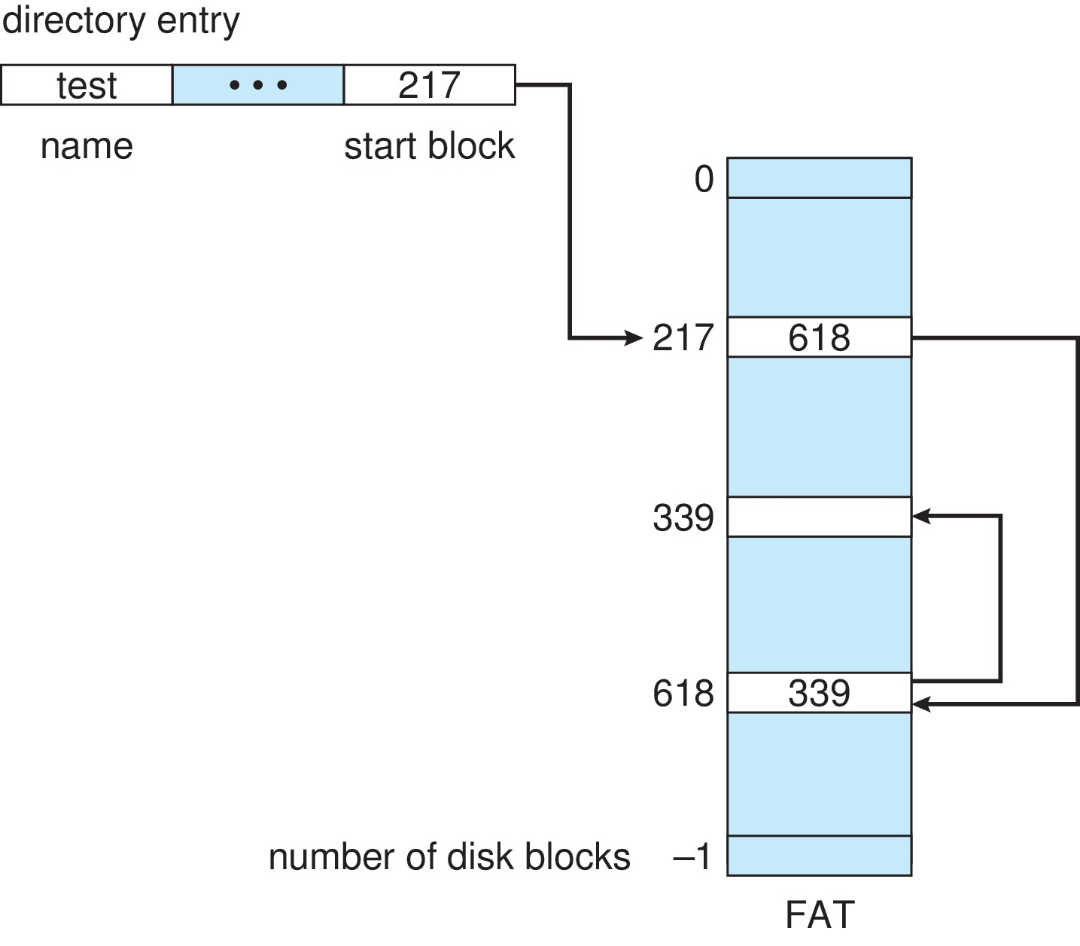
File–Allocation Table
Beginning of volume has table, indexed by block number
Much like a linked list, but faster on disk and cacheable
New block allocation simple
Notes:
Stored at the beginning of the hard disk or non-volatile memory so that when every yhr OS is loaded, then this is loaded in the memory.
Three blocks are required by the test file.
This is much faster than previous techniques because we are searching the blocks not in memory but in separate FAT.

Slide 41
Indexed Allocation Method
Each file has its own index block(s) of pointers to its data blocks
Logical view
Notes:
We should be able to add or remove blocks as soon as possible.

Slide 42
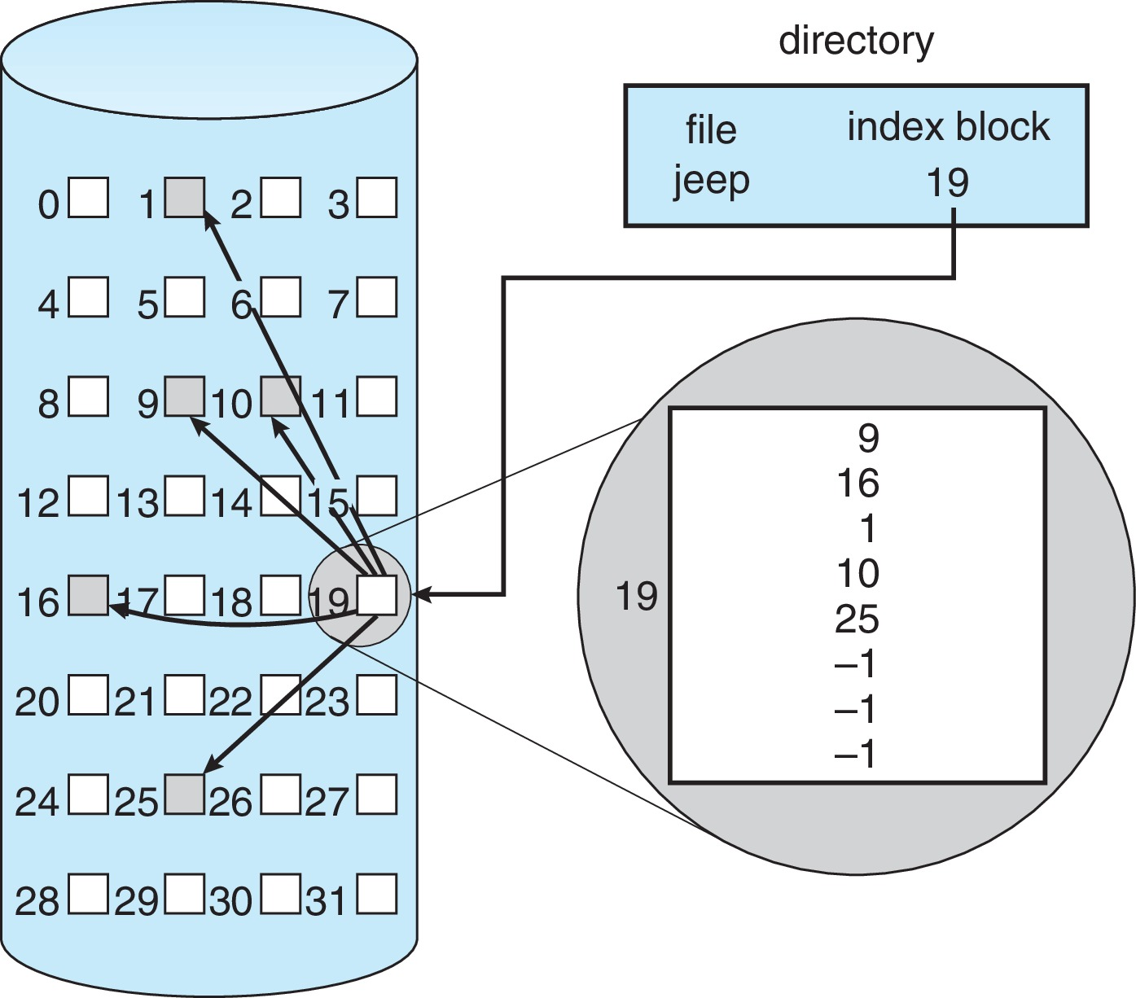
Example of Indexed Allocation
Pros:
Simplify seeks
Random access
Dynamic access without external fragmentation
May link indices together (for large files)
Cons:
Overhead of index block.
Size of index block?
Notes:
Jeep files block information is found at block 19.
Cons: limit the number of increases. We can't add more than five blocks because we only have three empty spaces (-1). Use linked list.
Overhead: Store the. Index table. We need to maintain extra information.
Mapping from logical to physical in a file of maximum size of 256K words and block size of 512 words. We need only one block for the index table.

Slide 43
Indexed Allocation (contd.)
We want index block as small as possible.
If too small, it will not be able to hold enough pointers for a large file.
Mechanism to deal with these issues:
Linked scheme
Link together several index blocks.
Multilevel index
A variant of linked representation uses a first-level index block to point to set of second-level index blocks, which in turn point to the file blocks.
Combined scheme
Notes:
It is small because we have less internal fragmentation. We don’t want to waste memory.

Slide 44
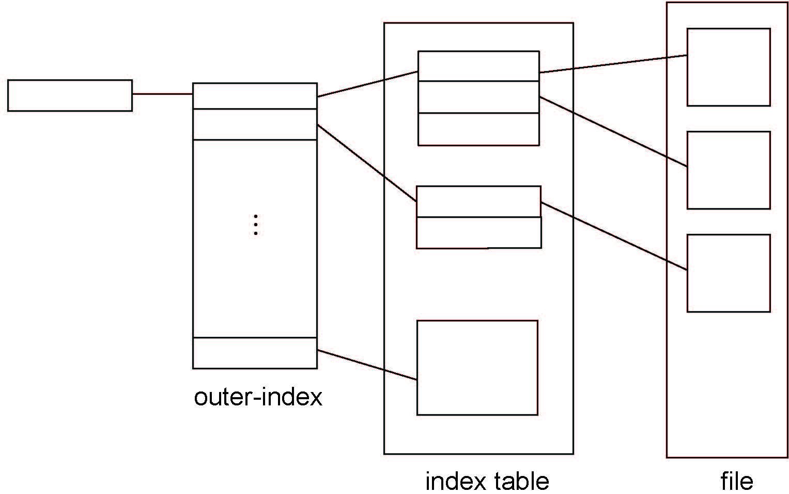
Indexed Allocation – Two-Level Scheme

Slide 45
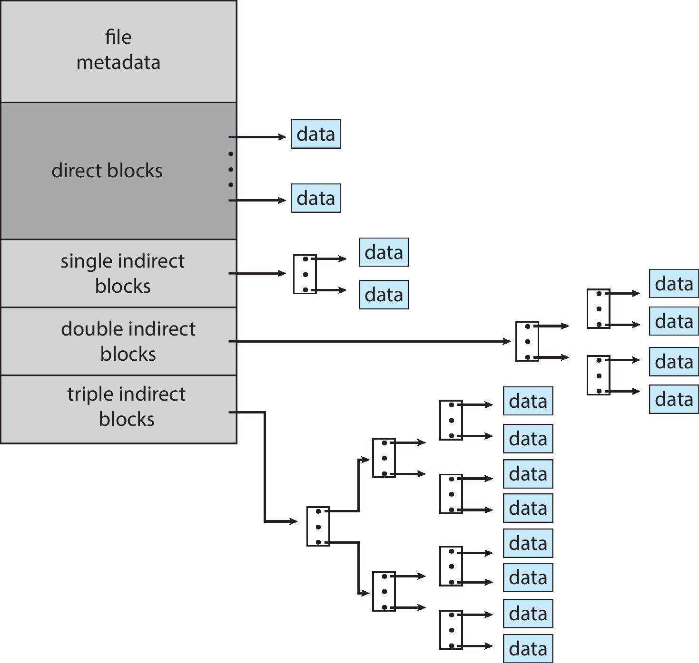
Combined Scheme : UNIX UFS
Another alternative.
For example, 15 pointers of the index block in the file’s inode.
The first 12 of these pointers point to direct blocks;
Next three pointers point to indirect blocks.
Single indirect block
Double indirect block
Triple indirect block
Notes:
4K bytes per block, 32-bit addresses
More index blocks than can be addressed with 32-bit file pointer
The first points to a single indirect block, which is an index block containing not data but the addresses of blocks that do contain data.
The second points to a double indirect block, which contains the address of a block that contains the addresses of blocks that contain pointers to the actual data blocks.
The last pointer contains the address of a triple indirect block.

